Slide 1


Solution Architecture figures
Purpose
  This document holds all figures and images used in the project documentation
Audience
  All Poseidon members

Slide 2
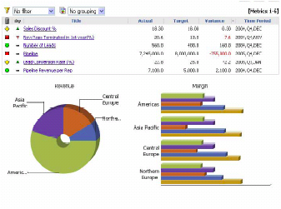






Analytics
Mobile
Social
Open Data
Cloud
services
Individual
Central
Individual
Individual
Open protocol
Internet of Things (sensors)

Slide 3

Users
Student
Enthusiast
Farmer
Developer
Use and
redo
to learn
Use APIs
Monitor
plant
Monitor
crops
Builds
new apps
Weather
Innovation A
Receives
weather data
Poseidon
Provides Open
Data via API
Maps
Innovation B
Utilizes
map data
Provides Open
Data via API
Provider Apps
Provide (near)
real-time
monitoring data
Provide (near)
real-time
monitoring data
Provide (near)
real-time
monitoring data
Consumer Apps
Internet of Things (sensors)

Slide 4
Run-time environment
Development & Collaboration Environment
External services
Social update
(Twitter)
Notification
(Mobile App)
REST/JSON
Platform as a Service (Bluemix)
IoT Event Flow
(Node-red)
Mobile and Desktop Visualisation
Development Cloud Environment (DevOps)
Internet of Things
Boilerplate
Automatic Deployment
NoSQL Datastore
(Cloudant)
IoT Event orchestration (Node-red)
Sensor Data Collection and Distribution API
Node.js
Track & Plan
Development Environment
MQTT
Internet of Things Cloud
Code repository (Git)
Sensor Data Broker
(MQTT Broker)
MQTT
Monitoring device
(Raspberry Pi + GrovePi extension board)
Sensor Data Collection and Distribution Client
sensor
sensor
sensor
Air pressure (barometer)
Temperature
Soil
moisture

